Slide 1
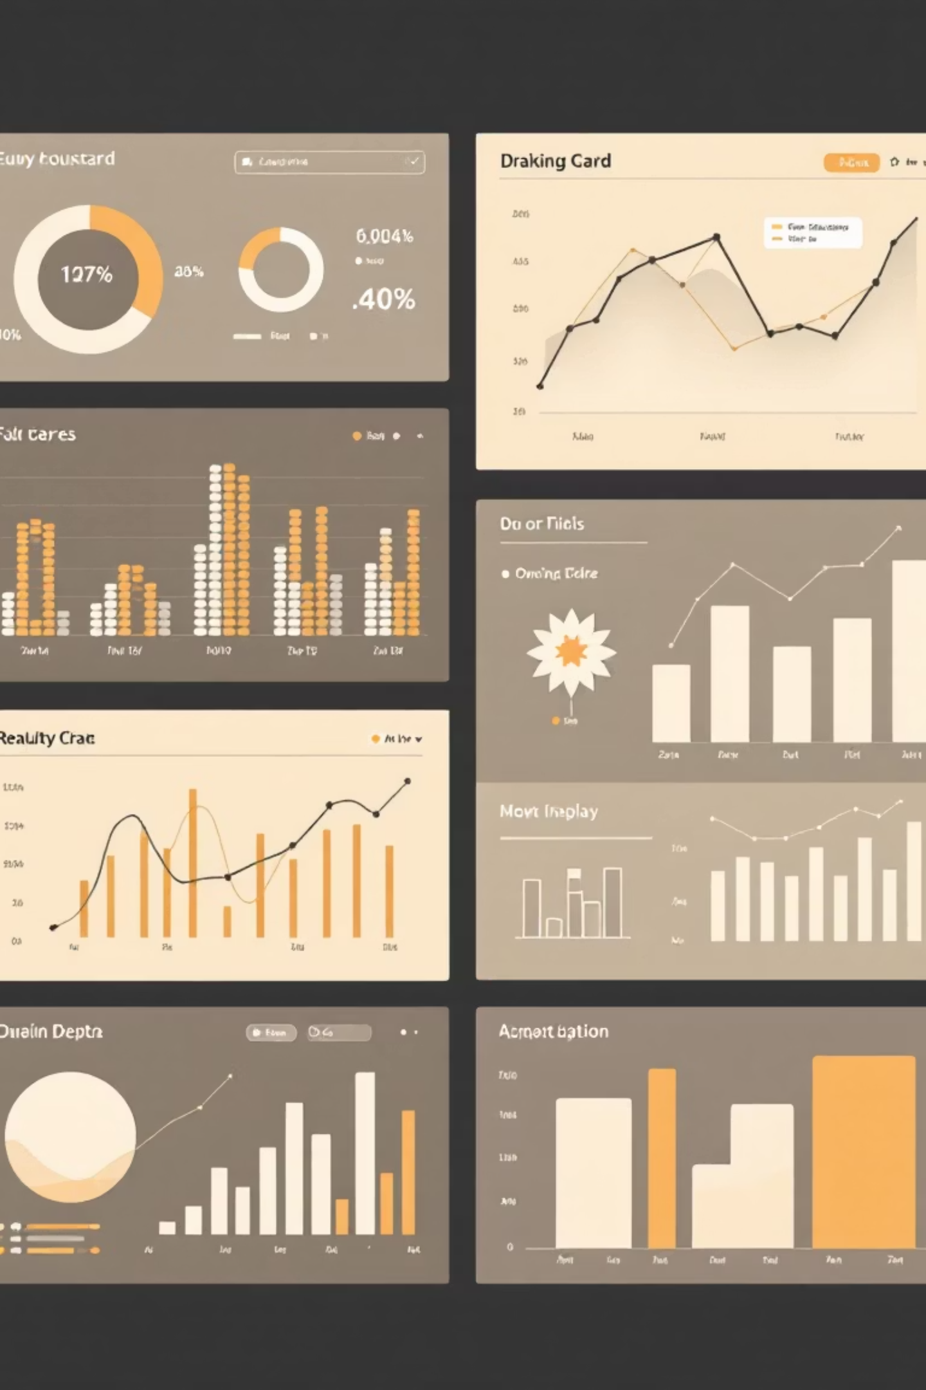
Just Store Executive Dashboard
Tableau Project | Executive Overview of Sales, Profit & Orders
Purpose: Present key findings from the Just Store Tableau dashboard and connect them to business actions.
Scope: Sales, profit, orders, customers, quantity with breakdowns by region, category, and time.

Slide 2
Agenda
01
02
03
Dashboard Goals & KPIs
Executive KPI Snapshot
Sales by Region
Core metrics overview
Top-line performance indicators
Geographic distribution analysis
04
05
06
Category Performance
Sales Trend Over Time
Key Insights
Sales & profit breakdown
Seasonality patterns
Critical takeaways
07
Recommendations & Next Steps
Action items and enhancements

Slide 3
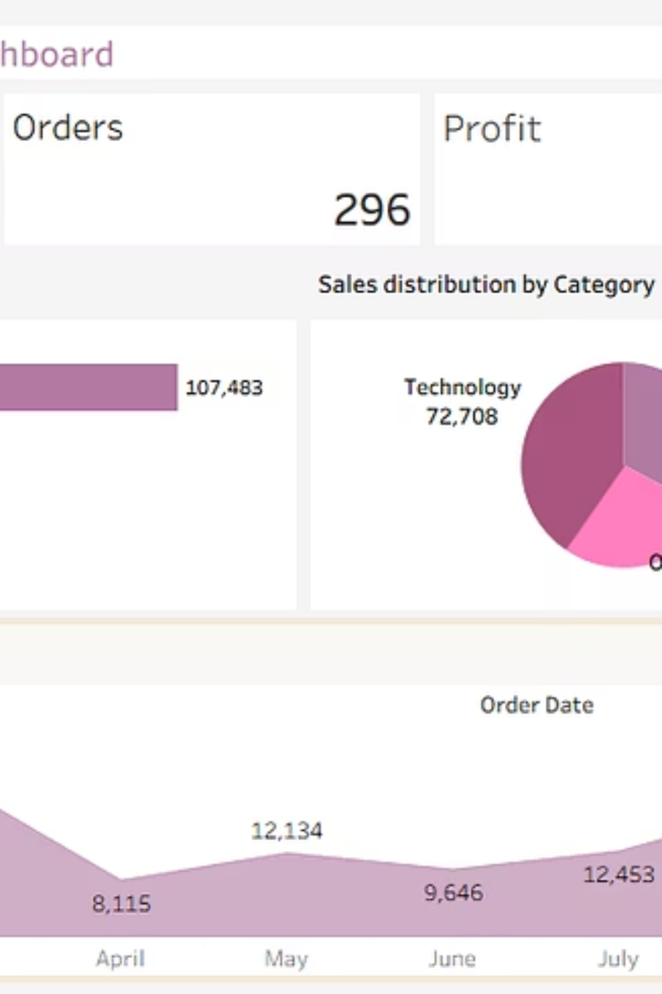
Dashboard Overview
Comprehensive view of Just Store's performance metrics across regions, categories, and time periods

Slide 4
Executive KPI Snapshot
247
296
$23K
$180.5K
Customers
Orders
Profit
Sales
Active buyers
Total transactions
Net earnings
Total revenue
3,053
Quantity
Units sold
Performance Highlights
Opportunity Area
$180.5K revenue from 296 orders and 247 customers
Improving repeat purchase rates can significantly boost profit efficiency and customer lifetime value
Positive profitability at $23K
Average order value: ~$610

Slide 5
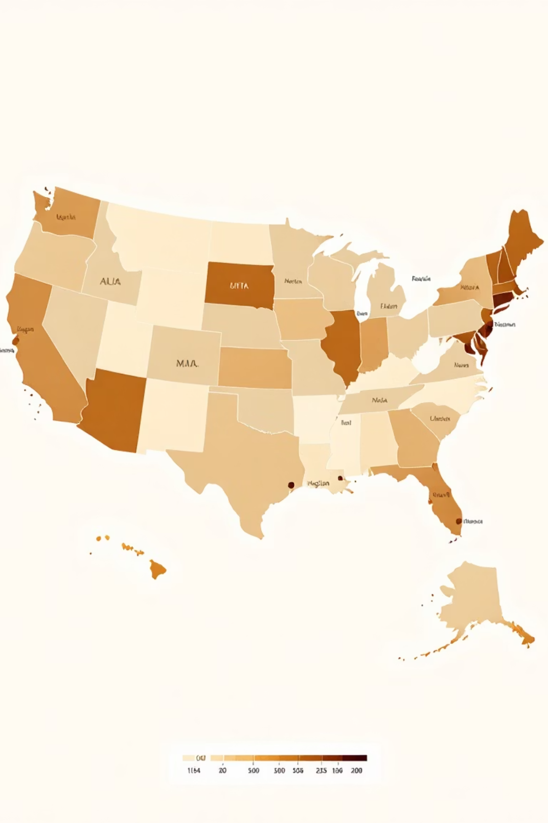
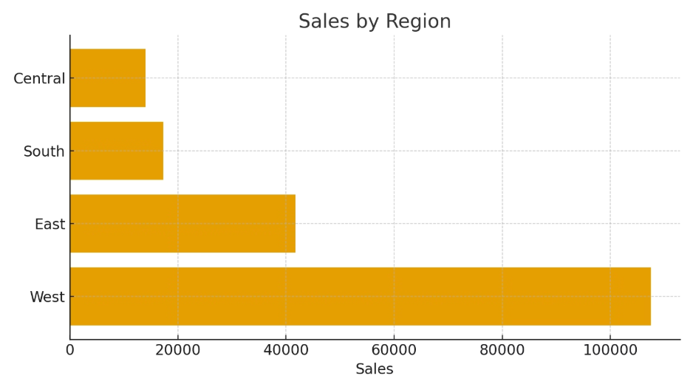
Sales by Region
West
Leading region with dominant market share and strongest performance
East
Moderate performance with stable contribution
South & Central
Smaller market share requiring targeted growth strategies

Slide 6
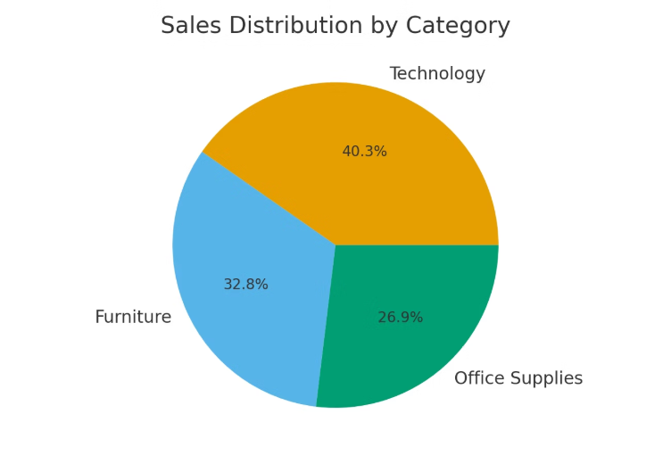
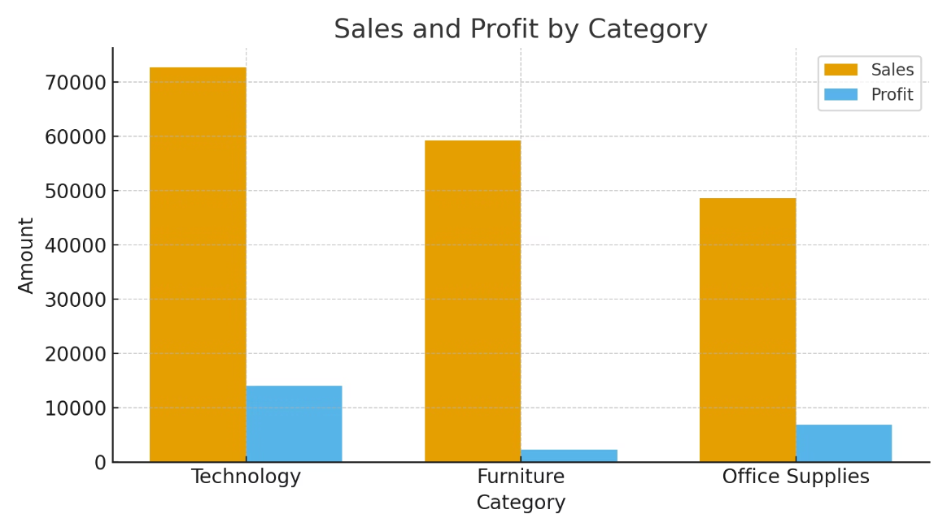
Category Performance
1
2
Technology
Furniture
Sales: $72.7K | Profit: ~$14.0K
Sales: ~$59.2K | Profit: ~$2.3K
Clear category leader with highest revenue and strongest profit margins
Second in sales but lowest profitability — requires pricing or cost optimization
3
Office Supplies
Sales: ~$48.6K | Profit: ~$6.9K
Solid mid-tier performer with balanced profit contribution

Slide 7
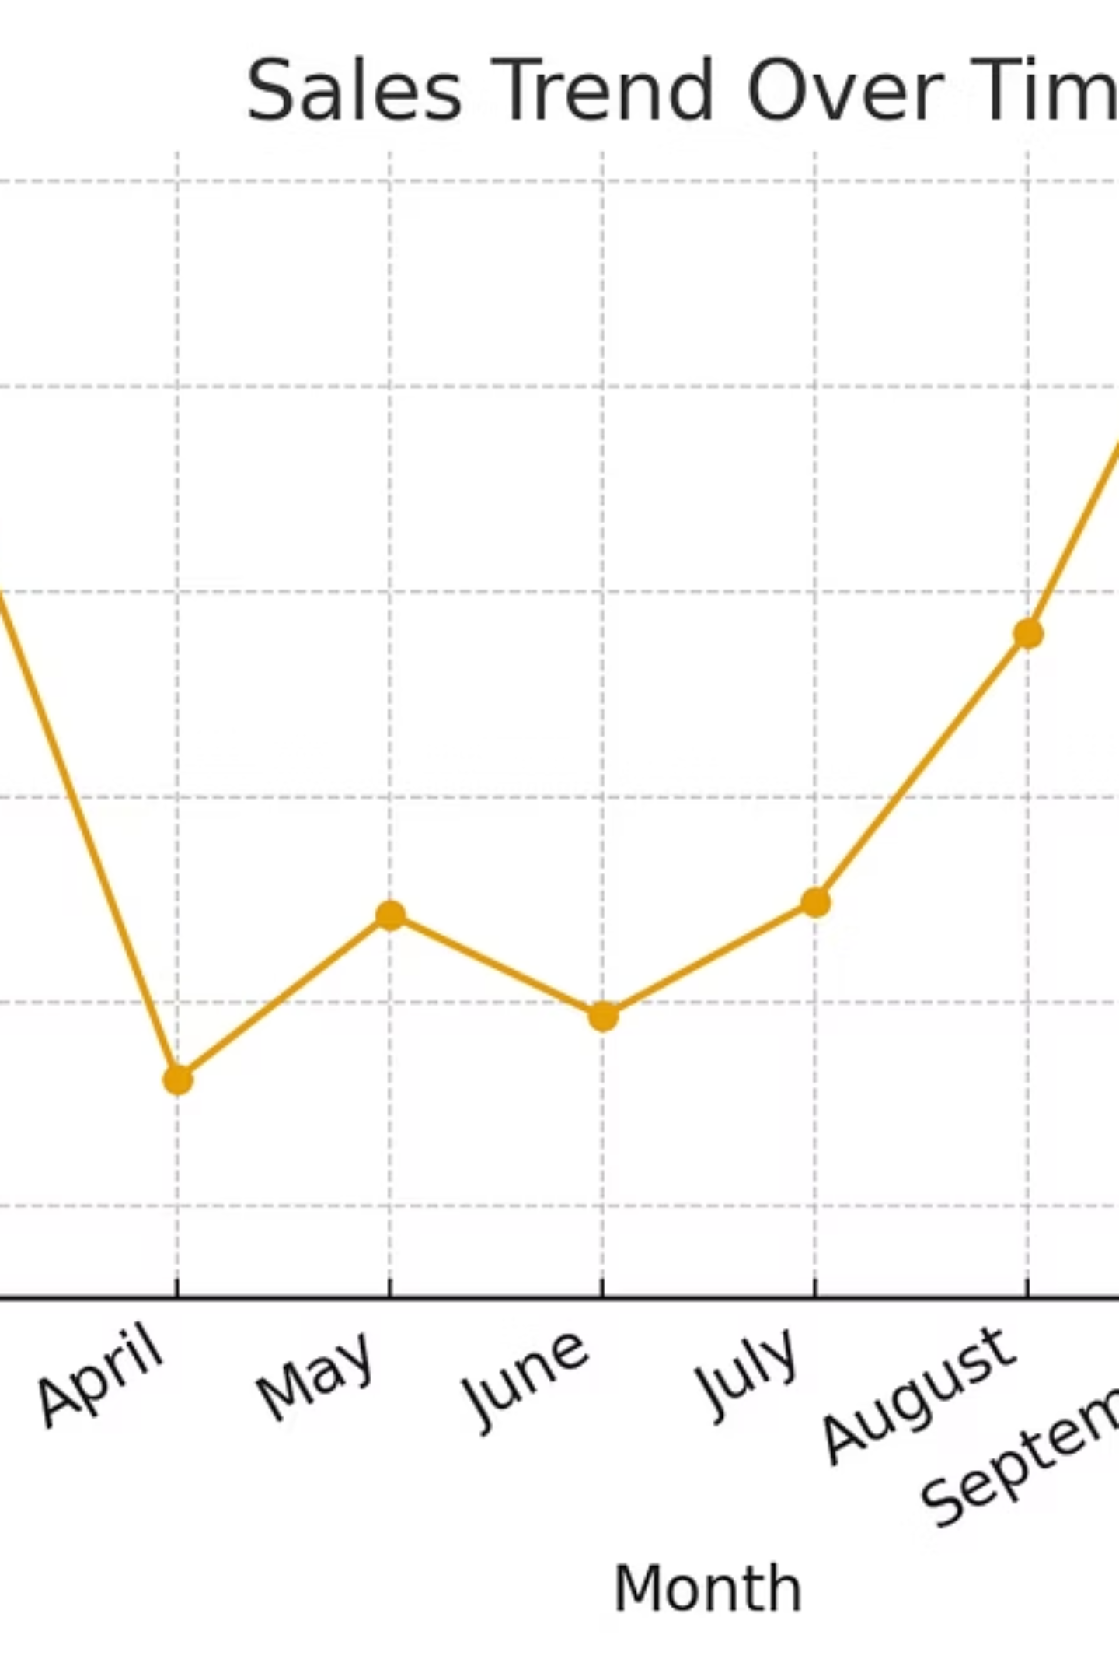

Sales Trend Over Time
1
Jan–Feb
Weakest period requiring promotional support
2
March
Strong peak suggesting seasonal opportunity
3
September
Back-to-school/fall surge
4
December
Year-end holiday-driven uplift
Action Item: Align inventory planning, staffing levels, and marketing campaigns with peak months to maximize revenue capture

Slide 8
Key Insights
Strong Overall Profitability
West Region Dominates
Technology Leads Performance
Primary revenue driver requiring continued investment and expansion
$23K profit on $180.5K sales demonstrates healthy business fundamentals
Best-performing category in both sales volume and profit margins
Furniture Margin Challenge
Clear Seasonality Pattern
Solid sales volume undermined by weak profit efficiency
Strong mid-year and year-end demand periods drive revenue concentration

Slide 9






Recommendations
Amplify West Region Success
Deploy localized promotions, expand product availability, and increase market penetration
Scale Technology Growth
Introduce bundling strategies, premium add-ons, and targeted B2B outreach programs
Fix Furniture Profitability
Renegotiate supplier terms, control discounting, implement margin-based pricing
Boost Underperforming Regions
Launch South/Central-specific offers and improve delivery service levels
Leverage Seasonal Peaks
Align marketing spend and inventory with March, September, December demand surges
Drive Customer Retention
Implement loyalty programs and repeat-purchase incentives to increase lifetime value

Slide 10

Next Steps to Enhance the Dashboard
Expand KPI Suite
Add profit margin % and average order value as headline metrics
Enable Deeper Drilldowns
Include sub-category and product-level views for granular insights
Customer Segmentation
Implement RFM analysis (recency, frequency, monetary value)
Historical Comparisons
Audit-Ready Reporting
Add year-over-year and monthly trend comparisons when multi-year data becomes available
Create dedicated table view slide or appendix with detailed numerical breakdowns

